Slide 1

Aerodynamics
Chapter 1 : Mathematical tools

Slide 2
Plan
Modelisation of quantities
Derivatives
Operators
Infinitesimal and Integrals

Slide 3
Modelisation of quantities
Physical quantities can be modelled by constants, variables or functions. They can be scalars, vectors or matrices.
Set Notation Einstein notation
Scalar $ℝ$ $f$ $f$
Vector $ℝ^{n}$ $\vec{u}$ $u_{i}$
Matrix $M_{m,n}(ℝ)$ $\vec{\vec{A}}$ $A_{i,j}$

Slide 4
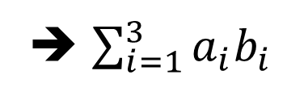


Einstein notation
Notation based on indices.
If, in a term, the same index is used several times ➔ Summation on this index
Ex :
$$a_{i}b_{i}$$
➔ $\sum_{i=1}^{3}{a_{i}b_{i}}$
➔Scalar
$$a_{i}b_{j}$$
➔Matrix

Slide 5
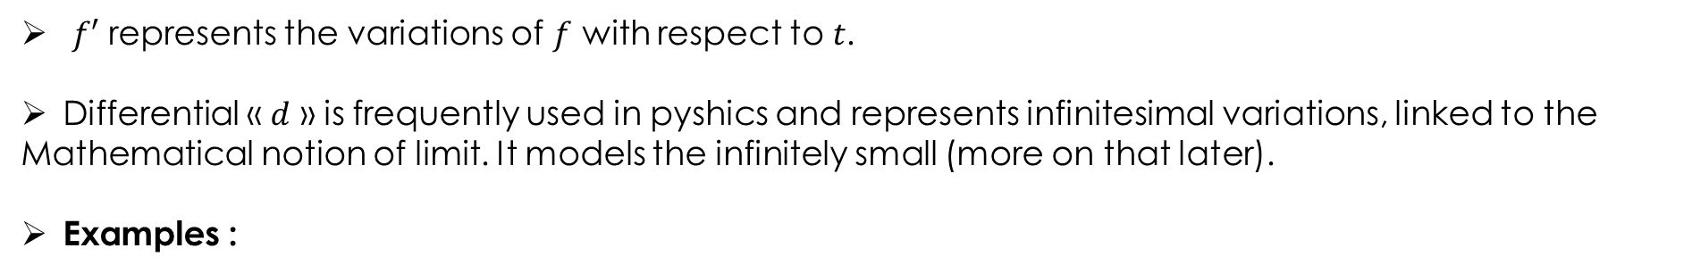
Derivatives
For a scalar function $f$ depending of a variable $t$( ex : physical quantity depending only of the time).
$$f^{′}\left(t_{1}\right)=\lim_{t_{2}→t_{1}}{\frac{f\left(t_{2}\right)−f(t_{1})}{t_{2}−t_{1}}}=\lim_{Δt→0}{\frac{f\left(t_{1}+Δt\right)−f\left(t_{1}\right)}{Δt}=\lim_{Δt→0}{\frac{Δf}{Δt}=\frac{ⅆf}{ⅆt} (t_{1})}}$$
$f′$ represents the variations of $f$ with respect to 𝑡.
Differential « $ⅆ$ » is frequently used in pyshics and represents infinitesimal variations, linked to the
Mathematical notion of limit. It models the infinitely small (more on that later).
Examples :
Velocity :
time derivative of position
Acceleration :
time derivative of velocity

Slide 6
Derivatives
Chain derivative : if $f$ depends on $θ$ which itself depends on $t$
$$\frac{df}{dt}=\frac{df}{dθ}\frac{dθ}{dt}$$
Ex : $f\left(θ\right)=sin(θ)$ et $θ={at}^{2}$.
$$\frac{df}{dt}=\frac{df}{dθ}\frac{dθ}{dt}=\cos\left(θ\right)×2at$$

Slide 7
Derivatives - Partial derivatives
For a scalar function $f$ dépending on several variables $t,x,y,z$( ex : physical quantities dépending on time and space).
$$\frac{∂f}{∂t}\left(t_{1},x,y,z\right)=\lim_{Δt→0}{\frac{f\left(t_{1}+Δt,x,y,z\right)−f\left(t_{1},x,y,z\right)}{Δt}}$$
The quantity represents variations of $f$ with respect to time only (on a fixed point in space).

Slide 8


Derivatives - Partial derivatives
Application : $f\left(t,x,y,z\right)=2t^{2}+3xy+4y^{3}+ e^{−t}\cos{z}$
Calculate $\frac{∂f}{∂t}\left(t,x,y,z\right)$, $\frac{∂f}{∂x}\left(t,x,y,z\right)$, $\frac{∂f}{∂y}\left(t,x,y,z\right)$ and $\frac{∂f}{∂z}\left(t,x,y,z\right)$
$$\frac{∂f}{∂t}=4t+ −exp\left(−t\right)∗cos(z)$$
$$\frac{∂f}{∂x}=3y$$
$$\frac{∂f}{∂y}=3x+12y²$$
$$\frac{∂f}{∂z}=−exp\left(−t\right)∗sin(z)$$
8

Slide 9
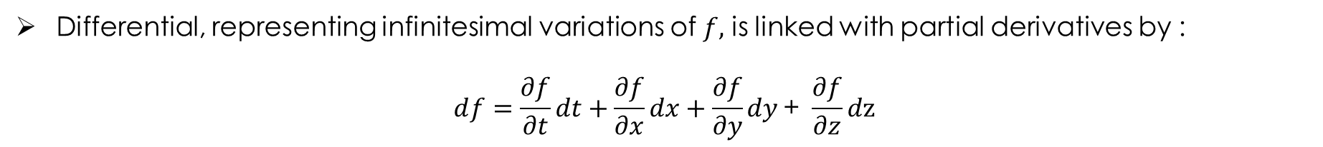
DERIVATIVES - DIFFERENTIAL
Differential, representing infinitesimal variations of $f,$ is linked with partial derivatives by :
$$ⅆf=\frac{∂f}{∂t}dt+\frac{∂f}{∂x}dx+\frac{∂f}{∂y}dy \text{+ }\frac{∂f}{∂z}d\text{z}$$

Slide 10
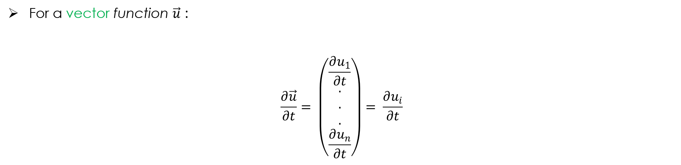
Derivatives – Vectorial functions
For a vector function $\vec{u}$ :
$$\frac{∂\vec{u}}{∂t}= \left(\begin{matrix}\frac{∂u_{1}}{∂t} \\ . \\ . \\ . \\ \frac{∂u_{n}}{∂t}\end{matrix}\right)= \frac{∂u_{i}}{∂t}$$

Slide 11
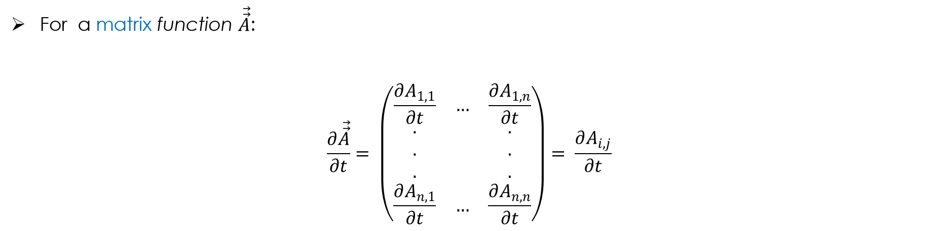
Derivatives – Matrix function
For a matrix function $\vec{\vec{A}}$:
$$\frac{∂\vec{\vec{A}}}{∂t}= \left(\begin{matrix}\frac{∂A_{1,1}}{∂t} & … & \frac{∂A_{1,n}}{∂t} \\ . & & . \\ . & & . \\ . & & . \\ \frac{∂A_{n,1}}{∂t} & … & \frac{∂A_{n,n}}{∂t}\end{matrix}\right)= \frac{∂A_{i,j}}{∂t}$$

Slide 12
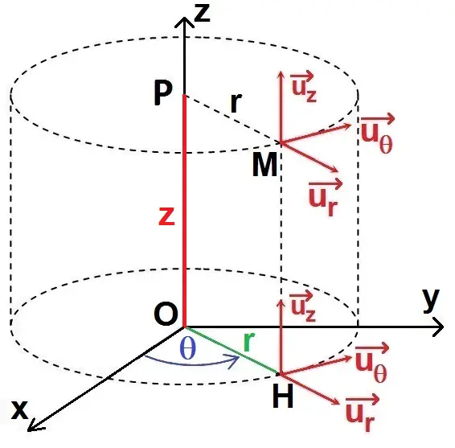

Operators
Operators applies to physical quantities depending on spatial variables, and will depend on the partial derivatives of the function on these spatial variables :
  Cartesian : $x, y, z$
  Cylindrical : $r,θ, z$
  Spherical : $r, θ, φ$
Some operators apply to scalars, some to vectors and others to matrices and
return a scalar, a vector or a matrix.
www.methodephysique.fr

Slide 13


Operators - Nabla
Nabla $\vec{∇}$
Cartesian
$$\vec{∇}=\left(\begin{matrix}\frac{∂}{∂x} \\ \frac{∂}{∂y} \\ \frac{∂}{∂z}\end{matrix}\right)$$
Einstein notation : $\frac{∂}{∂x_{i}}=∂_{i}$
Cylindrical
$$\vec{∇}=\left(\begin{matrix}\frac{∂}{∂r} \\ \frac{1}{r}\frac{∂}{∂θ} \\ \frac{∂}{∂z}\end{matrix}\right)$$

Slide 14


Operators - Gradient
Gradient $\vec{grad}\left(f\right)=\vec{∇}f$ [scalar ➔ vector]
Cartesian
$$\vec{∇}f=\left(\begin{matrix}\frac{∂f}{∂x} \\ \frac{∂f}{∂y} \\ \frac{∂f}{∂z}\end{matrix}\right)$$
Einstein notation : $\frac{∂f}{∂x_{i}}=∂_{i}f$
Cylindrical
$$\vec{∇}f=\left(\begin{matrix}\frac{∂f}{∂r} \\ \frac{1}{r}\frac{∂f}{∂θ} \\ \frac{∂f}{∂z}\end{matrix}\right)$$

Slide 15
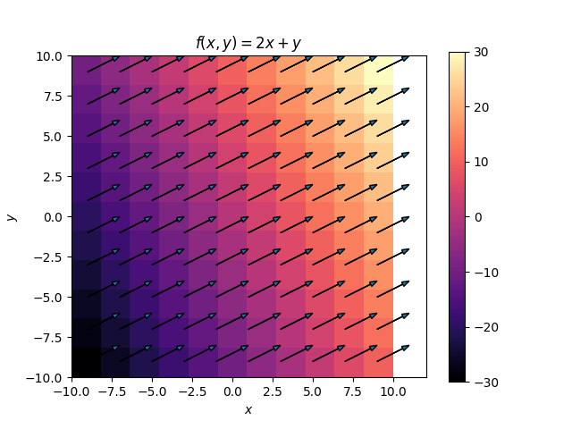
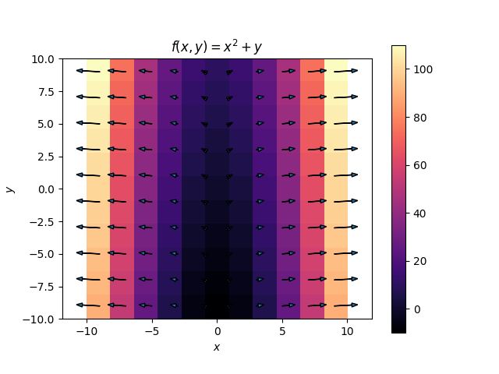
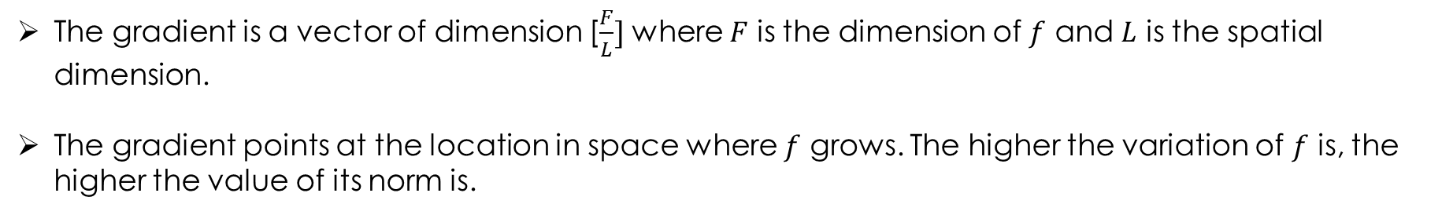
Operators - Gradient
The gradient is a vector of dimension [$\frac{F}{L}]$ where $F$ is the dimension of $f$ and $L$ is the spatial dimension.
The gradient points at the location in space where $f$ grows. The higher the variation of $f$ is, the higher the value of its norm is.

Slide 16


Operators - Gradient
Gradient for vector : Jacobian matrix $J_{ij}=\frac{∂u_{i}}{∂x_{j}}$ [Vector ➔ Matrix]
Cartesian
$$\vec{\vec{J}}=\left(\begin{matrix}\frac{∂u_{x}}{∂x} & \frac{∂u_{x}}{∂y} & \frac{∂u_{x}}{∂z} \\ \frac{∂u_{y}}{∂x} & \frac{∂u_{y}}{∂y} & \frac{∂u_{y}}{∂z} \\ \frac{∂u_{z}}{∂x} & \frac{∂u_{z}}{∂y} & \frac{∂u_{z}}{∂z}\end{matrix}\right)$$
Einstein notation : $\frac{∂u_{i}}{∂x_{j}}=∂_{j}u_{i}$
Cylindrical
$$\vec{\vec{J}}=\left(\begin{matrix}\frac{∂u_{r}}{∂r} & \frac{1}{r}\frac{∂u_{r}}{∂θ} & \frac{∂u_{r}}{∂z} \\ \frac{∂u_{θ}}{∂r} & \frac{1}{r}\frac{∂u_{θ}}{∂θ} & \frac{∂u_{θ}}{∂z} \\ \frac{∂u_{z}}{∂r} & \frac{1}{r}\frac{∂u_{r}}{∂θ} & \frac{∂u_{z}}{∂z}\end{matrix}\right)$$

Slide 17



Operators - divergence
Divergence $div\left(\vec{u}\right)=\vec{∇}⋅\vec{u}$ [vecteur ➔ scalaire]
Cartesian
$$\vec{∇}⋅\vec{u}=\frac{∂u_{x}}{∂x}+\frac{∂u_{y}}{∂y}+\frac{∂u_{z}}{∂z}$$
Cylindrical
$$\vec{∇}⋅\vec{u}=\frac{1}{r}\frac{∂{(ru}_{r})}{∂r}+\frac{1}{r}\frac{∂u_{θ}}{∂θ}+\frac{∂u_{z}}{∂z}$$
Einstein notation : $\frac{∂u_{i}}{∂x_{i}}=∂_{i}u_{i}$

Slide 18
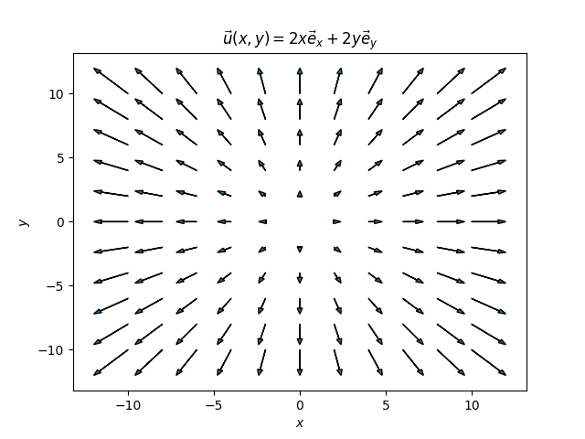
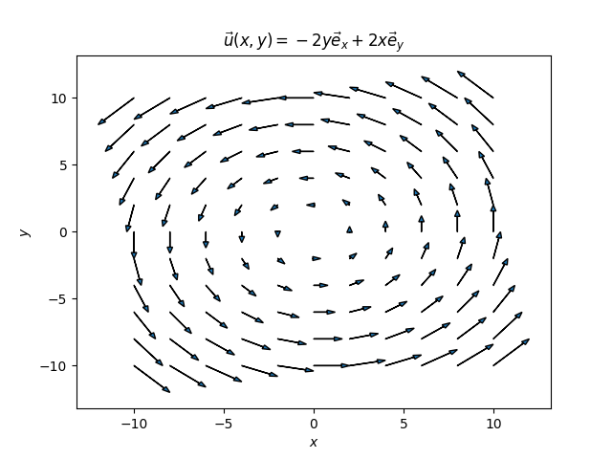




Operators - divergence
Divergence operator traduces variation of flow. Intuitively, divergence traduces if a vectorial field goes « in » or « out » of a spatial zone at point $(x,y,z)$.
For a vectorial field $\vec{u}\left(x,y,z\right)$, $\vec{∇}⋅\vec{u}=0$ induces that flow density of $\vec{u}$ is constant.
Ex : Calculate $\vec{∇}⋅\vec{u}$ for the following vectorial fields :
$$\vec{u}\left(x,y,z\right)=kx \vec{e_{x}}+ky \vec{e_{y}}$$
$$\vec{u}\left(x,y,z\right)=−ky \vec{e_{x}}+kx \vec{e_{y}}$$
$\vec{∇}⋅\vec{u}=k+k=2k$
$\vec{∇}⋅\vec{u}=0+0=0$

Slide 19


Operators – divergence for matrices
$div(\vec{\vec{A}})=\vec{∇}⋅\vec{\vec{A}}$ [Matrix ➔ Vector] : It consists on applying the operator of divergence of a vector on every lines of the matrix.
Cartesian
$$\vec{∇}⋅\vec{\vec{A}}=\left(\begin{matrix}\frac{∂A_{xx}}{∂x}+\frac{∂A_{yx}}{∂y}+\frac{∂A_{zx}}{∂z} \\ \frac{∂A_{xy}}{∂x}+\frac{∂A_{yy}}{∂y}+\frac{∂A_{yz}}{∂z} \\ \frac{∂A_{xz}}{∂x}+\frac{∂A_{yz}}{∂y}+\frac{∂A_{zz}}{∂z}\end{matrix}\right)$$
Einstein notation : $\frac{∂A_{ij}}{∂x_{i}}=∂_{i}A_{ij}$

Slide 20

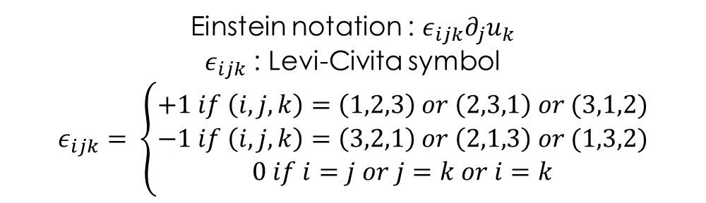

Operators -rotational
$\vec{rot}\left(\vec{u}\right)=\vec{∇}∧\vec{u}$ [vecteur ➔ vecteur]
Cartesian
$$\vec{∇}∧\vec{u}=\left(\begin{matrix}\frac{∂u_{z}}{∂y}−\frac{∂u_{y}}{∂z} \\ \frac{∂u_{x}}{∂z}−\frac{∂u_{z}}{∂x} \\ \frac{∂u_{y}}{∂x}−\frac{∂u_{x}}{∂y}\end{matrix}\right)$$
Cylindrical
$$\vec{∇}∧\vec{u}=\left(\begin{matrix}\frac{1}{r}\frac{∂u_{z}}{∂θ}−\frac{∂u_{θ}}{∂z} \\ \frac{∂u_{r}}{∂z}−\frac{∂u_{z}}{∂r} \\ \frac{1}{r}\frac{∂{(ru}_{θ})}{∂r}−\frac{1}{r}\frac{∂u_{r}}{∂θ}\end{matrix}\right)$$
Einstein notation : $ε_{ijk}∂_{j}u_{k}$
$ε_{ijk}$ : Levi-Civita symbol
$$ε_{ijk}= \left\{\begin{aligned}+1 if \left(i,j,k\right)=\left(1,2,3\right) or \left(2,3,1\right) or (3,1,2) \\ −1 if \left(i,j,k\right)=\left(3,2,1\right) or \left(2,1,3\right) or (1,3,2) \\ 0 if i=j or j=k or i=k\end{aligned}\right.$$

Slide 21


Operators - rotational
As its name shows, rotational measures the local rotation of the vector field at point $\left(x,y,z\right).$
Ex : Calculate $\vec{∇}∧\vec{u}$ for the following vectorial fields :
$$\vec{u}\left(x,y,z\right)=kx \vec{e_{x}}+ky \vec{e_{y}}$$
$$\vec{u}\left(x,y,z\right)=−ky \vec{e_{x}}+kx \vec{e_{y}}$$
$$\vec{∇}∧\vec{u}=\vec{0}$$
$\vec{∇}∧\vec{u}=2k \vec{e_{z}}$

Slide 22
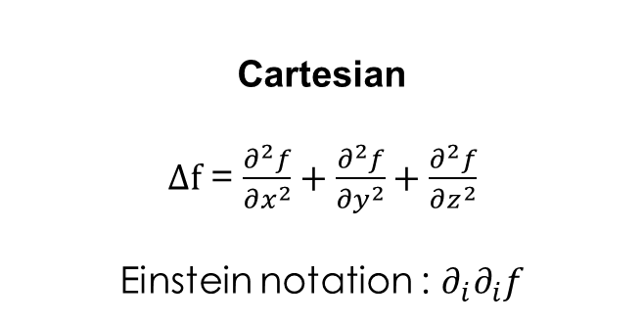

Operators – laplacian
$div\left(\vec{grad(f)}\right)=\vec{∇}⋅\left(\vec{∇}f\right)=Δf$ [Scalar ➔ Scalar]
Cartesian
$Δf$ = $\frac{∂^{2}f}{∂x^{2}}+\frac{∂^{2}f}{∂y^{2}}+\frac{∂^{2}f}{∂z^{2}}$
Einstein notation : ${∂_{i}∂}_{i}f$
Cylindrical
$$Δf\text{ = }\frac{∂^{2}f}{∂r^{2}}+\frac{1}{r}\frac{∂f}{∂r}+\frac{1}{r^{2}}\frac{∂^{2}f}{∂θ^{2}}+\frac{∂^{2}f}{∂z^{2}}$$

Slide 23
Operators – laplacian for vectors
It consists on applying Laplacian for scalars for every components of the vectorial field to obtain a vector. [Vector ➔ Vector]
$Δ\vec{u}=\left(\begin{matrix}Δu_{1} \\ Δu_{2} \\ Δu_{3}\end{matrix}\right)$

Slide 24
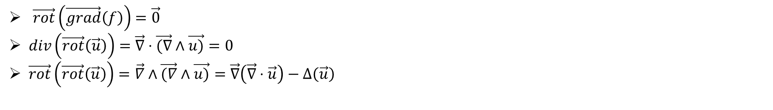
Operators – Relations
$\vec{rot}\left(\vec{grad}\left(f\right)\right)=\vec{0}$
$div\left(\vec{rot}\left(\vec{u}\right)\right)=\vec{∇}⋅\vec{(∇}∧\vec{u)}=0$
$\vec{rot}\left(\vec{rot}\left(\vec{u}\right)\right)=\vec{∇}∧\vec{(∇}∧\vec{u)}=\vec{∇}\left(\vec{∇}⋅\vec{u}\right)−Δ\left(\vec{u}\right)$

Slide 25

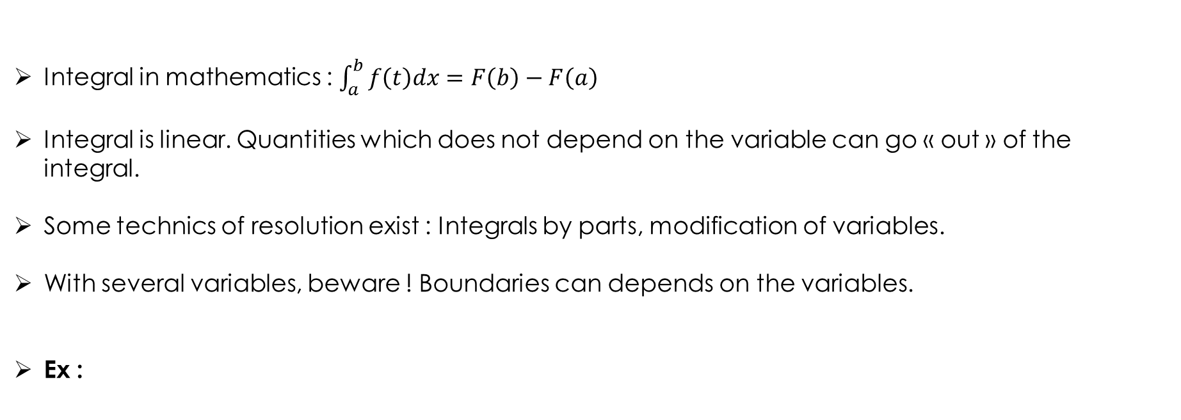
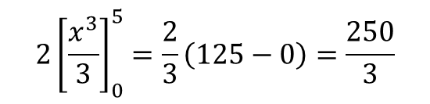
Infinitesimal and integrals
Integral in mathematics : $\int_{a}^{b}{f\left(t\right)dx=F\left(b\right)−F\left(a\right)}$
Integral is linear. Quantities which does not depend on the variable can go « out » of the integral.
Some technics of resolution exist : Integrals by parts, modification of variables.
With several variables, beware ! Boundaries can depends on the variables.
Ex :
$$\int_{0}^{5}{{2x}^{2}} dx=$$
$$2{\left[\frac{x^{3}}{3}\right]}_{0}^{5}=\frac{2}{3}\left(125−0\right)=\frac{250}{3}$$

Slide 26

Infinitesimal and integrals
Modification of variables : $\int_{a}^{b}{f\left(u\left(x\right)\right)\frac{du}{dx} dx= \int_{u(a)}^{u(b)}{f\left(u\right)du} }$

Slide 27




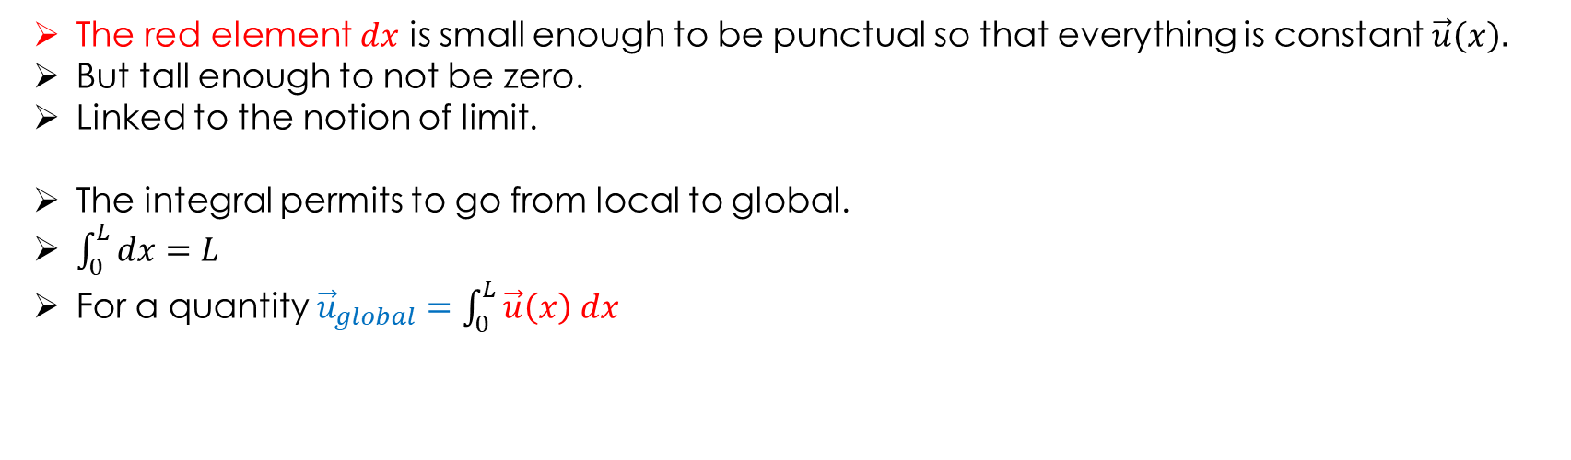

Infinitesimal and integrals
$$L$$
$$x$$
$$x+dx$$
$$x$$
$$dx$$
The red element $dx$ is small enough to be punctual so that everything is constant $\vec{u}\left(x\right).$
But tall enough to not be zero.
Linked to the notion of limit.
The integral permits to go from local to global.
$\int_{0}^{L}{dx=L}$
For a quantity ${\vec{u}}_{global}=\int_{0}^{L}{\vec{u}\left(x\right) dx}$

Slide 28





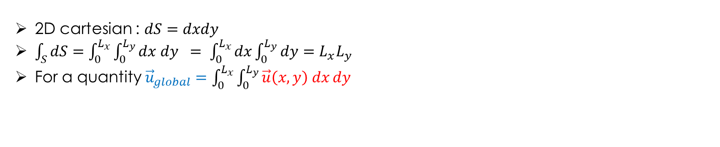


Infinitesimal and integrals
$$y$$
$$L_{x}$$
$$x,y$$
$$dy$$
$$L_{y}$$
$$dx$$
$$x$$
2D cartesian : $dS=dxdy$
$\int_{S}{dS=\int_{0}^{L_{x}}{\int_{0}^{L_{y}}{dx dy }}= \int_{0}^{L_{x}}{dx\int_{0}^{L_{y}}{dy}=L_{x}L_{y}}}$
For a quantity ${\vec{u}}_{global}=\int_{0}^{L_{x}}{\int_{0}^{L_{y}}{\vec{u}\left(x,y\right) dx}}dy$

Slide 29

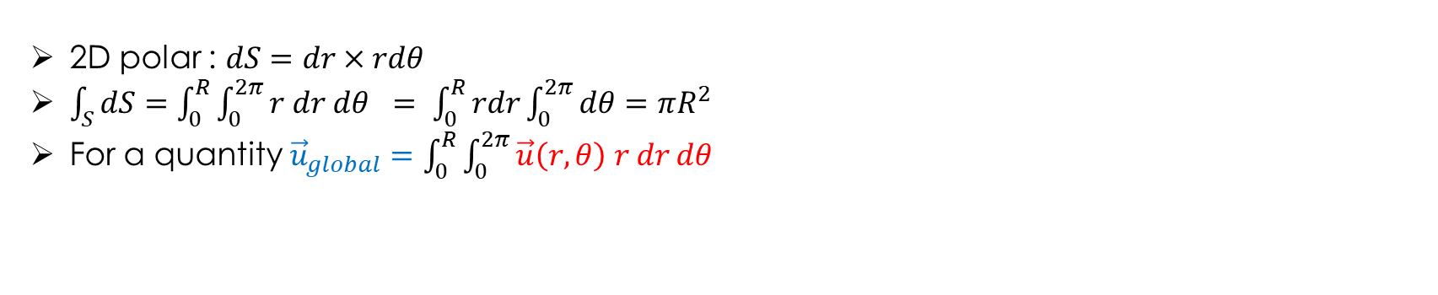



Infinitesimal and integrals
$$rdθ$$
$$dr$$
$$r$$
$$R$$
2D polar : $dS=dr×rdθ$
$\int_{S}{dS=\int_{0}^{R}{\int_{0}^{2π}{r dr dθ }}= \int_{0}^{R}{rdr\int_{0}^{2π}{dθ}=πR^{2}}}$
For a quantity ${\vec{u}}_{global}=\int_{0}^{R}{\int_{0}^{2π}{\vec{u}\left(r,θ\right) r dr}}dθ$

Slide 30
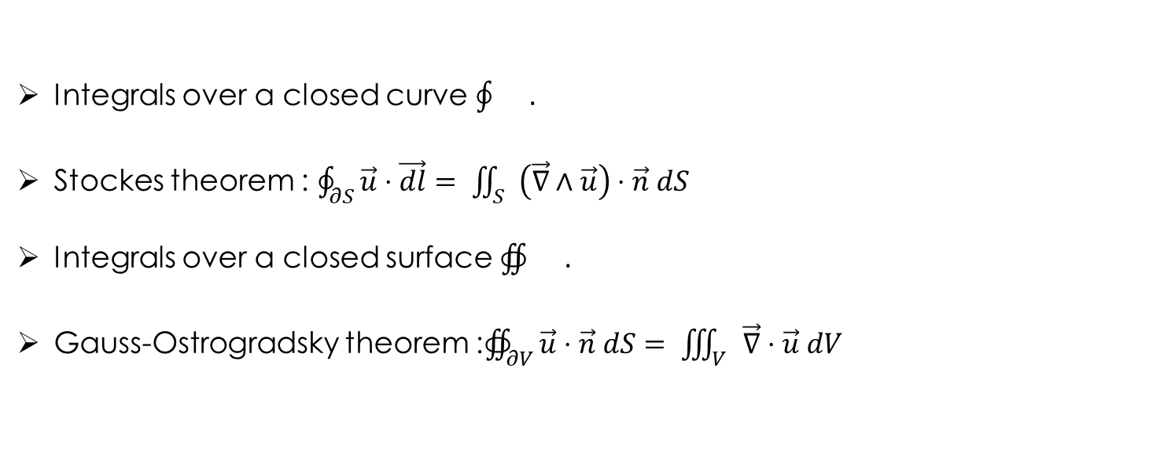
Infinitesimal and integrals
Integrals over a closed curve $\oint{}.$
Stockes theorem : $\oint_{∂S}{\vec{u}⋅\vec{dl}= \iint_{S}{\left(\vec{∇}∧\vec{u}\right)⋅\vec{n} dS}}$
Integrals over a closed surface $∯{}.$
Gauss-Ostrogradsky theorem :$∯_{∂V}{\vec{u}⋅\vec{n} dS= \iiint_{V}{\vec{∇}⋅\vec{u} dV}}$

